Slide 1
Discrete and Continuous Multimedia
Time always takes separate dimension in the media representation
Based on time-dimension in the representation space, media can be
  Time-independent (Discrete)
    Text, Graphics
  Time dependent (Continuous)
    Audio, Video
    Video, sequence of frames (images) presented to the user periodically.
    Time dependent aperiodic media is not continuous!!
  Discrete & Continuous here has no connection with internal representation !! (relates to the viewers impression…)

Slide 2
Interactive Multimedia
---When the user is given the option of controlling the elements.
Hyper Media
---A combination of hypertext, graphics, audio, video, (linked elements) and interactivity culminating in a complete, non-linear computer-based experience.

Slide 3
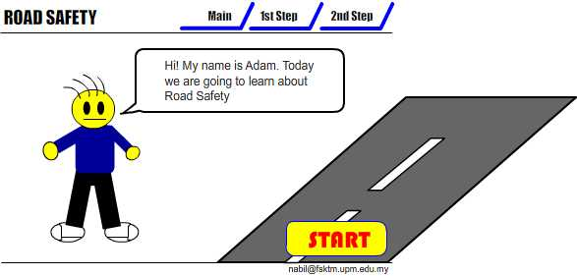
Example
Interactive Multimedia

Slide 4
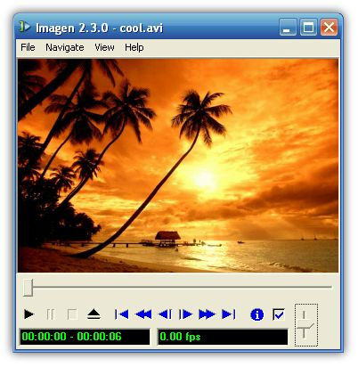

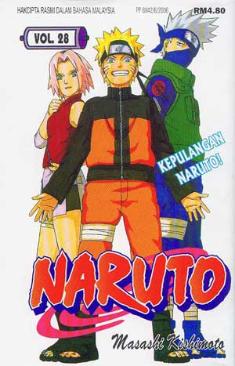
Example
Hyper Media
Main Page
Video link
Image link
Audio Link

Slide 5
Linear VS Non-Linear
LINEAR
A Multimedia Project is identified as Linear when:
  It is not interactive
  User have no control over the content that is being showed to them.
Example:
  A movie
  A non-interactive lecture / demo show

Slide 6
Linear VS Non-Linear
NON-LINEAR
A Multimedia Project is identified as Non-Linear when:
  It is interactive
  Users have control over the content that is being showed to them.
  Users are given navigational control
Example:
  Games
  Courseware
  Interactive CD

Slide 7
Overview of Multimedia Software Tools
The categories of software tools brieﬂy examined here
1. Music Sequencing and Notation
2. Digital Audio
3. Graphics and Image Editing
4. Video Editing
5. Animation
6. Multimedia Authoring

Slide 8
Music Sequencing and Notation
Cakewalk: now called Pro Audio.
– The term sequencer comes from older devices that stored sequences
of notes (“events”, in MIDI).
– It is also possible to insert WAV ﬁles and Windows MCI commands
(for animation and video) into music tracks
(MCI is a ubiquitous component of the Windows API.)
Cubase: another sequencing/editing program, with capabilities similar to
those of Cakewalk. It includes some digital audio editing tools.
Macromedia Soundedit: mature program for creating au-dio for multimedia
projects and the web that integrates well with other Macromedia products
such as Flash and Director.

Slide 9
Graphics and Image Editing
Adobe Illustrator: a powerful publishing tool from Adobe. Uses vector graphics; graphics can be exported to Web.
Adobe Photoshop: the standard in a graphics, image processing and manipulation tool.
– Allows layers of images, graphics, and text that can be separately
manipulated for maximum ﬂexibility.
– Filter factory permits creation of sophisticated lighting-eﬀects ﬁlters.
Macromedia Fireworks: software for making graphics specifically for the web.
Macromedia Freehand: a text and web graphics editing tool that supports many bitmap formats such as GIF, PNG, and JPEG.

Slide 10
Digital Audio
Digital Audio tools deal with accessing and editing the actual sampled sounds that make up audio:
–Cool Edit: a very powerful and popular digital audio toolkit; emulates a professional audio studio —multitrack productions and sound ﬁle editing including digital signal processing eﬀects.
– Sound Forge: a sophisticated PC-based program for editing audio WAV ﬁles.
–Pro Tools: a high-end integrated audio production and editing environment — MIDI creation and manipulation; powerful audio mixing, recording, and editing software.

Slide 11
Video Editing
Adobe Premiere: an intuitive, simple video editing tool for nonlinear editing, i.e., putting video clips into any order:
– Video and audio are arranged in “tracks”.
– Provides a large number of video and audio tracks, superimpositions and
virtual clips.
– A large library of built-in transitions, ﬁlters and motions for clips ⇒ eﬀective
multimedia productions with little eﬀort.
Adobe After Eﬀects: a powerful video editing tool that enables users to add and change existing movies. Can add many eﬀects: lighting, shadows, motion blurring; layers.
Final Cut Pro: a video editing tool by Apple; Macintosh only.

Slide 12
Animation
Multimedia APIs:
– Java3D: API used by Java to construct and render 3D graphics, similar to the
way in which the Java Media Framework is used for handling media ﬁles.
1. Provides a basic set of object primitives (cube, splines, etc.) for building
scenes.
2. It is an abstraction layer built on top of OpenGL or DirectX (the user can
select which).
–DirectX: Windows API that supports video, images, audio and 3-D animation
–OpenGL: the highly portable, most popular 3-D API.

Slide 13
Multimedia Authoring
Multimedia Authoring are the tools that provide are called authoring programs. the capability for creating a complete multimedia presentation , including interactive user control, are called authoring programs.

Slide 14
Multimedia Authoring Programs
Software that allows the designer to:
  Create multimedia presentations
  Create interactive elements
  Design screen layouts
  Produce content with paint, text, and animation tools
  Incorporate text, sound, video, animation, and graphics
  Create hyperlinks

Slide 15
Multimedia Authoring
Macromedia Flash: allows users to create interactive movies by using the score metaphor, i.e., a timeline arranged in parallel event sequences.
Macromedia Director: uses a movie metaphor to create interactive presentations — very powerful and includes a builtin scripting language, Lingo, that allows creation of complex interactive movies.
Authorware: a mature, well-supported authoring product based on the Iconic/Flow-control metaphor.
Quest: similar to Authorware in many ways, uses a type of ﬂowcharting metaphor. However, the ﬂowchart nodes can encapsulate information in a more abstract way (called frames) than simply subroutine levels.

Slide 16
What is Text
Basic media for many multimedia systems
Texts in the form of words, sentences and paragraphs is used to communicate thoughts, ideas and facts in nearly every aspect of our lives.
Multimedia products depends on text for many things:
- to explain how the application work
- to guide the user in navigating through the application
- deliver the information for which the application was
designed

Slide 17
What is Text
Minimize the texts in multimedia application
Texts consists of two structures:
  Linear
  Non-Linear

Slide 18
Text Technology
Based on creating letters, numbers and special characters.
Text elements can be categories into:
  Alphabet characters : A - Z
  Numbers : 0 - 9
  Special characters : Punctuation [. , ; ‘ …] , Sign or Symbols [* & ^ % $ £ ! /\ ~ # @ .…]
  Also known Character Sets
May also include special icon or drawing symbols, mathematical symbols, Greek Letter etc.

Slide 19
Typefaces, Fonts and Points
Typefaces
The graphic representations of the alphabet, numbers and special character.
Usually vary by type sizes and styles.
Fonts
Particular size of typefaces
Usually vary by type sizes and styles.
The sizes are measured in points
  - One point is 1/72” or 0.0138 inc”
  Measuring distance from the top of a capital letters (e.g. ‘A or P’) to the
  bottom of a descenders (e.g. ‘y , ‘p’ , ‘q’).

Slide 20
Fonts Effects
A numbers of effects that are useful for bringing viewer’s attention to content:
  Case: UPPER and lower letter
  Bold, Italic, Underline, ^{superscript} or _{subscript}
  Embossed or Shadow
  Colours
  b
Strikethrough

Slide 21
Types of Fonts
Two classes of fonts: Serif or Sans Serif
Serif fonts use decorative tips or flags at the ends of a letter strokes
Sans Serif fonts don’t have these features
Serif fonts are usually used for documents or screens that have large quantities of text
  - This is because the serif helps guide the reader’s eye along the text

Slide 22
Types of Fonts
For computer displays, Sans Serif fonts considered better because of the sharper contrast.
  Times New Roman
  Bookman
  Rockwell Light
  Courier New
  Century
Examples of San Serif fonts
  Century Gothic
  Arial
  Comic Sans MS
  Impact
  Tahoma
Examples of Serif fonts

Slide 23
Text Characteristics
This example shows the Times New Roman font
Ascender
Capital Height
x-Height
FD xhp
Serif
p -Height
Point size
Descender

Slide 24
Tracking, Kerning and Leading
Tight
tracking
Loose
tracking
Av
A
v
Unkerned
Kerned

Slide 25
Tracking, Kerning and Leading
Reading Line One
Reading Line One
Leading
Ascender : an upstroke on a character
Descender : the down stroke below the baseline of a character
Leading : spacing above and below a font or Line spacing
Tracking : spacing between characters
Kerning : space between pairs of characters, usually as an overlap for improvement appearance

Slide 26
Bitmapped and vector fonts
Fonts can either be stored as bitmapped or vector graphics
Bitmaps font depend to the size and the pixel numbers - File size increases as more sizes are added
Vector fonts can draw any size by scaling the vector drawing primitives mathematically
  - File size is much smaller than bitmaps
  - TrueType and PostScript are vector font formats

Slide 27
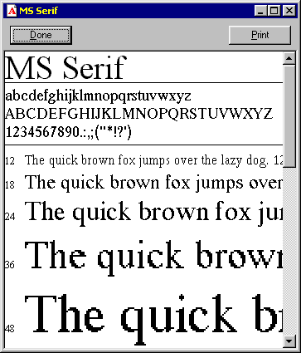
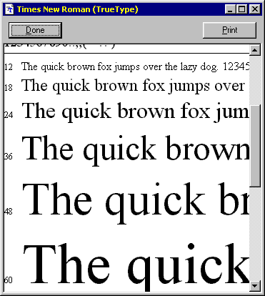
Bitmapped and vector fonts
A bitmapped font
A vector font

Slide 28
Postscript
Apple spearheaded desktop publishing by adopting Adobe’s PostScript
  Page description language for printing to Apple’s LaserWriter
  Characters were stored in a bitmap table representing every character at every size
PostScript is vector-based: describes characters in terms of mathematical constructs (e.g., Bezier curves)
  Facilitates scaling, drawing characters at various sizes and in various resolutions

Slide 29
TrueType
But PostScript represents fonts for printer and screen separately
  Adobe Type Manager accesses a font’s outline in the printer font
  Scales it to display to the right size on a screen
Apple introduces TrueType circa 1989
  Only one file per font, for printer & screen, no need for ATM utility to do mapping
  Both PostScript and TrueType universally available

Slide 30
Jaggies and Antialiasing
Jaggies are the jagged edges you see when a bitmapped image is resized
It is a consequence of the underlying array of pixels from which the image is composed
Antialiasing is a technique that can be used to eliminate jagged edges
It substitutes additional pixels in other colours to fool the brain into thinking it is seeing continuous lines

Slide 31
Jaggies and Antialiasing
The technique is used to blend the font into the background by transitioning the colour from the font colour to background.
This technique minimizes the jagged edges making for a smoother overall appearance.

Slide 32
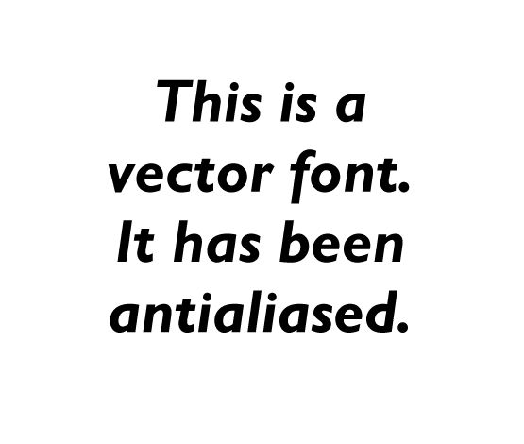

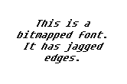

Jaggies and Antialiasing

Slide 33
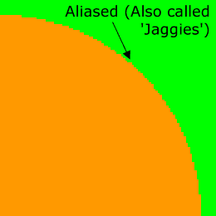
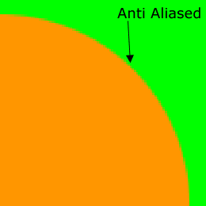


Anti-aliasing
Both PostScript and TrueType fonts allow text to be drawn on any size without jaggies
  (jagged edges on the outlines of a character)
Anti-aliasing exploits color by blending (dithering) colors along the edges of letter

Slide 34
Text Data Files
The common data encoding schemes for text are:
Plain text (ASCII) is text in an electronic format that can be read and interpreted by humans
Rich text is similar but it also embeds special control characters into the text to provide additional features
Hypertext is an advance on rich text which allows the reader to jump to different sections within the document or even jump to a new document

Slide 35
Text Data Files
Plain text
This is plain text. It is readable by humans. It can contains numbers (01234) and punctuation (.,#@*&) since it uses the ASCII character set.
Rich text
This is <bold>rich text</bold>.<br><center>It is also readable by humans but contains additional tags which control the presentation of the text.</center>
Hypertext
This is <a href=“http://www.w3c.org/”>hypertext</a>. It uses the rich text format shown above but adds the ability to hyperlink to other documents.<hr><img src=“logo.gif”>

